Slide 1

Trustees
Duties and responsibilities

Slide 2
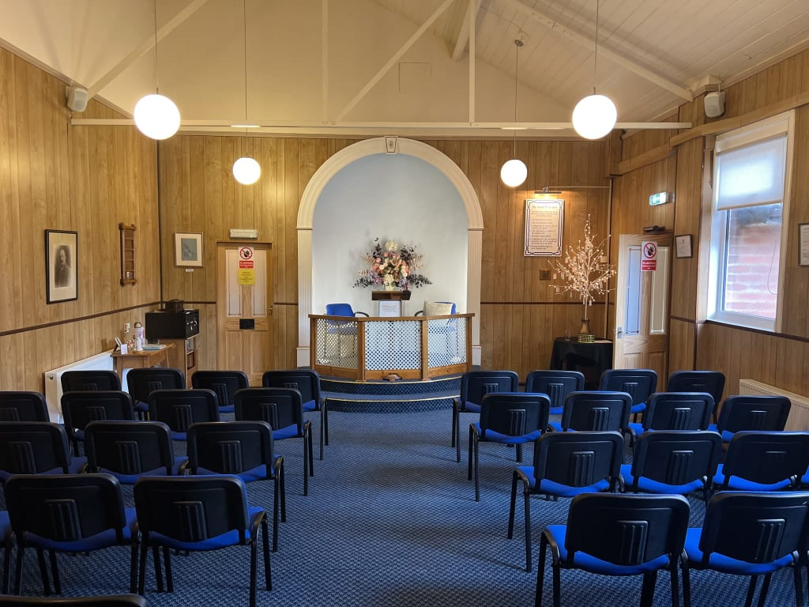
The church committee
Trustees have overall control of a charity and are responsible for making sure it’s doing what it was set up to do.
Trustees are the people who lead the charity and decide how it is run. Being a trustee means making decisions that will impact on people’s lives. Depending on what the charity does, you will be making a difference to your local community or to society as a whole.
Trustees use their skills and experience to support their charities, helping them achieve their aims. Trustees also often learn new skills during their time on the board.

Slide 3
Aims of an SNU Church
The objects of the Church are to advance the religion and the religious philosophy of Spiritualism on the basis of the Seven Principles of SNU Spiritualism
Rules for Church’s – Schedule 1 & 2 set out the Seven Principles and an explanation of them and Schedule 2 advises on Church Activities

Slide 4
Are you eligible?
You must be at least 16 years old to be a trustee of a charity that is a company or a charitable incorporated organisation (CIO), or at least 18 to be a trustee of any other sort of charity.
You must be properly appointed following the procedures and any restrictions in the charity’s governing document.
You must not act as a trustee if you are disqualified unless authorised to do so by a waiver from the Commission. The reasons for disqualification are shown in the disqualifying reasons table and include:
Having an unspent conviction for certain offences (including any that involve dishonesty or deception)
Being on the sex offenders’ register
Being bankrupt or having an individual voluntary arrangement (IVA)

Slide 5
Trustees six main duties 1
Ensure your charity is carrying out its purposes for the public benefit
You and your co-trustees must make sure that the charity is carrying out the purposes for which it is set up, and no other purpose. This means you should:
Ensure you understand the charity’s purposes as set out in its governing document
Plan what your charity will do, and what you want it to achieve
Be able to explain how all of the charity’s activities are intended to further or support its purposes
Understand how the charity benefits the public by carrying out its purposes
Spending charity funds on the wrong purposes is a very serious matter; in some cases trustees may have to reimburse the charity personally.

Slide 6
Trustees six main duties 2
Comply with your charity’s governing document and the law
You and your co-trustees must:
Make sure that the charity complies with its governing document
Comply with charity law requirements and other laws that apply to your charity
You should take reasonable steps to find out about legal requirements, for example by reading relevant guidance or taking appropriate advice when you need to.
Registered charities must keep their details on the register up to date and ensure they send the right financial and other information to the commission in their annual return or annual update.

Slide 7
Trustees six main duties 3
Act in your charity’s best interests
You must:
Do what you and your co-trustees (and no one else) decide will best enable the charity to carry out its purposes
With your co-trustees, make balanced and adequately informed decisions, thinking about the long term as well as the short term
Avoid putting yourself in a position where your duty to your charity conflicts with your personal interests or loyalty to any other person or body
Not receive any benefit from the charity unless it’s properly authorised and is clearly in the charity’s interests; this also includes anyone who is financially connected to you, such as a partner, dependent child or business partner

Slide 8
Trustees six main duties 4
Manage your charity’s resources responsibly
You must act responsibly, reasonably and honestly. This is sometimes called the duty of prudence. Prudence is about exercising sound judgement. You and your co-trustees must:
Make sure the charity’s assets are only used to support or carry out its purposes
Not take inappropriate risks with the charity’s assets or reputation
Not over-commit the charity
Take special care when investing or borrowing
Comply with any restrictions on spending funds
You and your co-trustees should put appropriate procedures and safeguards in place and take reasonable steps to ensure that these are followed. Otherwise you risk making the charity vulnerable to fraud or theft, or other kinds of abuse, and being in breach of your duty.

Slide 9
Trustees six main duties 5
Act with reasonable care and skill
As someone responsible for governing a charity, you:
Must use reasonable care and skill, making use of your skills and experience and taking appropriate advice when necessary
Should give enough time, thought and energy to your role, for example by preparing for, attending and actively participating in all trustees’ meetings

Slide 10
Trustees six main duties 6
Ensure your charity is accountable
You and your co-trustees must comply with statutory accounting and reporting requirements. You should also:
Be able to demonstrate that your charity is complying with the law, well run and effective
Ensure appropriate accountability to members, if your charity has a membership separate from the trustees
Ensure accountability within the charity, particularly where you delegate responsibility for particular tasks or decisions to staff or volunteers

Slide 11
Making decisions as a trustee
Charity trustees make decisions about their charity together, working as a team. Decisions don’t usually need to be unanimous as long as the majority of trustees agree. They’re usually made at charity meetings.
When you and your co-trustees make decisions about your charity, you must:
Act within your powers
Act in good faith, and only in the interests of your charity
Make sure you are sufficiently informed, taking any advice you need
Take account of all relevant factors you are aware of
Ignore any irrelevant factors
Deal with conflicts of interest and loyalty
Make decisions that are within the range of decisions that a reasonable trustee body could make in the circumstances
You should record how you made more significant decisions in case you need to review or explain them in the future.

Slide 12
A good trustee
You should enjoy your work on the committee
You should recognize the importance of your role
You should be proud to be a Spiritualist
You should plan for the future of your Church
You should encourage membership in the Church, this will provide the next generation of committee

Slide 13
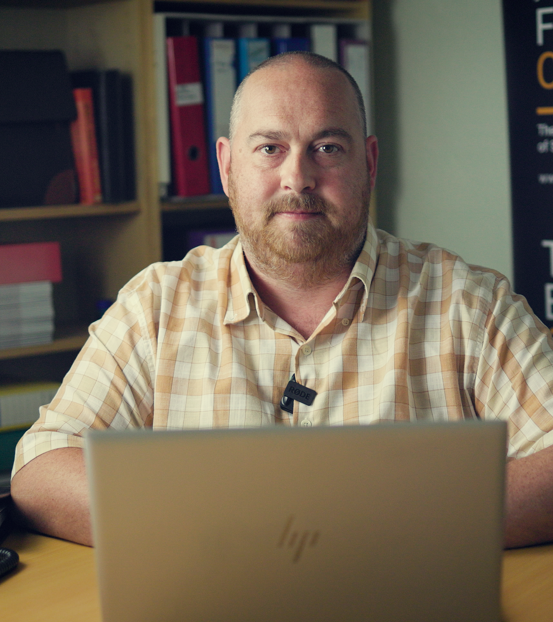
How to Contact your
Church relations coordinator:
Matthew Mold matthew.mold@snu.org.uk

